Slide 1
Exploring and Visualizing Data
Stephen F Elston| Principle Consultant, Quantia Analytics, LLC

Slide 2
Module Outline
Exploring Data
Visualizing Data

Slide 3
Exploring Data
Introduction to R and Python for Data Science
Working with Data Frames in R and Python
Working with Data Frames in Azure ML
Working with Metadata

Slide 4
Data Frames
Available in R and Python Pandas
Map to and from Azure ML tables
Rectangular tables
Each column of one type
Common Tasks:
Subsetting by rows and columns
Logical filtering of rows and columns
Column1 | Column2 | … | ColumnN
1 | ABC | … | 12.2
2 | XYZ | … | 13.1
3 | ABC | … | 12.8
4 | XYZ | … | 10.9
5 | ABC | … | 3.75

Slide 5
Dplyr

Slide 6
library(dplyr)

Slide 7
Col1 | Col2 | Col3
2012 | 14 | 45
2013 | 13 | 76
2013 | 34 | 65
2014 | 23 | 47
dir <- "C:\data"
file <- "values.csv"
path <- file.path(dir, file)
frame1 <- read.csv(path, header=TRUE, stringsAsFactors = FALSE)

Slide 8
Col1 | Col2 | Col3
2012 | 14 | 45
2013 | 13 | 76
2013 | 34 | 65
2014 | 23 | 47
Col1 | Col2 | Col3
2013 | 13 | 76
2013 | 34 | 65
frame1 <- filter(frame1, Col1 == 2013)

Slide 9
Col1 | Col3
2012 | 45
2013 | 76
2013 | 65
2014 | 47
Col1 | Col2 | Col3
2012 | 14 | 45
2013 | 13 | 76
2013 | 34 | 65
2014 | 23 | 47
frame1 <- select(frame1, Col1, Col3)

Slide 10
Col1 | Col2 | Col3 | Col4
2012 | 14 | 45 | 59
2013 | 13 | 76 | 89
2013 | 34 | 65 | 99
2014 | 23 | 47 | 70
Col1 | Col2 | Col3
2012 | 14 | 45
2013 | 13 | 76
2013 | 34 | 65
2014 | 23 | 47
frame1 <- mutate(frame1, Col4 = Col2 + Col3)

Slide 11
Other useful dplyr verbs include:
frame1 <- group_by(frame1, Col1)
frame1 <- distinct(frame1, Col1)
frame1 <- sample_frac(frame1, 0.5)
frame1 <- sample_n(frame1, 500)
frame1 <- summarize(frame1, m1 = mean(Col1))

Slide 12
Col1 | Col2 | Col3 | Col4
2013 | 13 | 76 | 89
2013 | 34 | 65 | 99
Col1 | Col2 | Col3
2012 | 14 | 45
2013 | 13 | 76
2013 | 34 | 65
2014 | 23 | 47
frame1 <- frame1 %>%
filter(Col1 == 2013) %>%
mutate(Col4 = Col2 + Col3)

Slide 13
Using a Data Frame in R

Slide 14
Pandas

Slide 15
Col1 | Col2 | Col3
2012 | 14 | 45
2013 | 13 | 76
2013 | 34 | 65
2014 | 23 | 47
import pandas as pd
import os
dir = "c:\data"
file = "values.csv"
path = os.path.join(dir, file)
frame1 = pd.read_csv(path)

Slide 16
Col1 | Col2 | Col3
2012 | 14 | 45
2013 | 13 | 76
2013 | 34 | 65
2014 | 23 | 47
Col2
14
13
34
23
frame1 = frame1["Col2"]

Slide 17
Col1 | Col2 | Col3
2012 | 14 | 45
2013 | 13 | 76
2013 | 34 | 65
2014 | 23 | 47
Col1 | Col2
2012 | 14
2013 | 13
2013 | 34
2014 | 23
frame1 = frame1[["Col1", "Col2"]]

Slide 18
Col1 | Col2 | Col3
2013 | 13 | 76
2013 | 34 | 65
Col1 | Col2 | Col3
2012 | 14 | 45
2013 | 13 | 76
2013 | 34 | 65
2014 | 23 | 47
frame1 = frame1[1:3:1]

Slide 19
Col1 | Col2 | Col3
2012 | 14 | 45
2013 | 13 | 76
2013 | 34 | 65
2014 | 23 | 47
Col1 | Col2 | Col3
2012 | 14 | 45
2013 | 13 | 76
2013 | 34 | 65
frame1 = frame1[:3]

Slide 20
Col1 | Col2 | Col3
2012 | 14 | 45
2013 | 13 | 76
2013 | 34 | 65
2014 | 23 | 47
Col2
14
13
frame1 = frame1["Col2"][1:2]

Slide 21
Col1 | Col2 | Col3
2012 | 14 | 45
2013 | 13 | 76
2013 | 34 | 65
2014 | 23 | 47
Col1 | Col2 | Col3
4 | 4 | 4
2013 | 21 | 58.25
0.816497 | 9.763879 | 14.863266
2012 | 13 | 45
2012.75 | 13.75 | 46.5
…
frame1 = frame1.describe()

Slide 22
Col1 | Col2 | Col3
2012 | 14 | 45
2013 | 13 | 76
2013 | 34 | 65
2014 | 23 | 47
Col1 | Col2 | Col3 | Col4
2012 | 14 | 45 | 59
2013 | 13 | 76 | 89
2013 | 34 | 65 | 99
2014 | 23 | 47 | 70
frame1["Col4"] = frame1["Col2"] + frame1["Col3"]

Slide 23
Col1 | Col2 | Col3
2012 | 14 | 45
2013 | 13 | 76
2013 | 34 | 65
2014 | 23 | 47
Col1 | Col2
2012 | 14
2013 | 13
2013 | 34
2014 | 23
frame1.drop("Col3", axis=1, inplace=True)

Slide 24
Other Useful Methods
isnull()
groupby(key|expression, axis)
copy()
where(Boolean)

Slide 25
Other Operations
Pandas.DataFrame.apply(function, axis)
Pandas.Series.Map(function, dictionary | series)
Pandas.DataFrame.applymap(function)

Slide 26
Col1 | Col2 | Col3
2012 | 14 | 45
2013 | 13 | 76
2013 | 34 | 65
2014 | 23 | 47
Col2 | Col3
14 | 45
47 | 141
23 | 47
frame1= frame1.groupby("Col1").sum()

Slide 27
Using a Data Frame in Python

Slide 28
R Data Frames in Azure ML

Slide 29
Azure ML
Dataset
Azure ML Table
Execute R Script
Data Frame

Slide 30
1
2
frame1 <- maml.mapInputPort(1)
frame2 <- maml.mapInputPort(2)
source("src/myScript.R")
print("Hello world")
maml.mapOutputPort("frame1")
R Device Port

Slide 31
Copying R Code to Azure ML

Slide 32
Python Data Frames in Azure ML

Slide 33
Azure ML
Dataset
Azure ML Table
Execute Python Script
Data Frame

Slide 34
1
2
def azureml_main(frame1, frame2)
import myModule as mm
print("Hello world")
return frame1
Device Port

Slide 35
Copying Python Code to Azure ML

Slide 36
Data Types and Metadata
Stephen F Elston | Principle Consultant , Quantia Analytics, LLC

Slide 37
Chapter Overview
Data types
Continuous and discreet values
Categorical variables
Azure ML tools
Quantization of categorical variables

Slide 38
Azure ML Table Data Types
Numeric; Floating Point
Numeric: Integer
Boolean
String
Categorical
Date-time
Time-Span
Image
Data type is Metadata

Slide 39
Continuous vs discrete variables
Continuous variable can take on any value within the resolution
Temperature
Distance
Weight
Discrete variables have fixed values
Number of people
Number of wheels on a vehicle

Slide 40
Categorical variables
Categories are metadata
Too many categories can lead to problems
Not enough data per category
Too many dimensions in a model
Often need to combine categories
Reduce number of categories
Group like categories

Slide 41
Continuous vs categorical variables
Categories are metadata
Too many categories can lead to problems
Not enough data per category
Too many dimensions in a model
Often need to combine categories
Reduce number of categories
Group like categories

Slide 42
The Azure ML Metadata Editor
Meta data includes:
Data type
Categories of categorical data
Field type; feature, label, etc.
Column name
Editor enables manipulation of metadata

Slide 43
Quantizing Continuous Variables
Convert continuous variable to categorical
Bin values into categories
Small, medium, large
Hot, cold
Income groups

Slide 44
Visualizing Data

Slide 45
Overview
Exploratory data analysis through visualization
The R ggplot2 package
The Python Pandas plotting and matplotlib package

Slide 46
Exploratory data analysis
Explore the data with visualization
Understand the relationships in the data
Create multiple views of data
Aesthetics to project multiple dimensions
Conditioning to project multiple dimensions
Understand sources of model errors
John Tukey, Exploratory Data Analysis, 1977, Addison-Westley

Slide 47
Views of data
Relationships in data can be complex
Data exploration requires multiple views
Views reveal different aspects of the relationships
Different plots highlight different relationships

Slide 48
Different plots for different views
Scatter
Scatter plot matrix
Line plots
Bar plots
Histograms
Box plots
Violin plots
Q-Q plots

Slide 49
Aesthetics for visualization
Allow projection of additional dimensions
But don’t over do it!
Color
Shape
Size
Transparency
Aesthetics specific to plot type

Slide 50
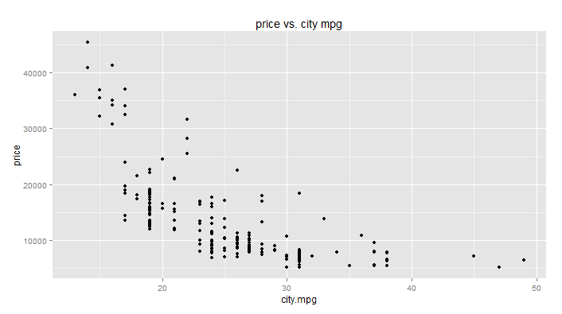
Scatter plot

Slide 51
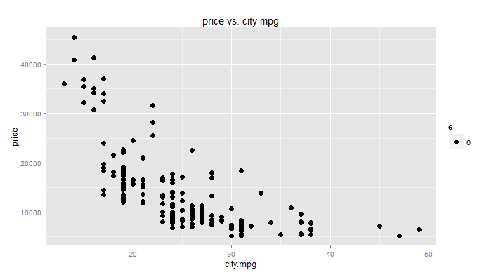
Scatter plot (larger point size)

Slide 52
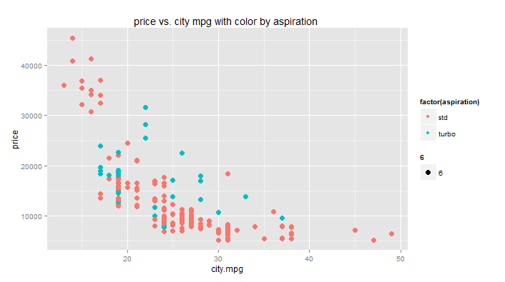
Scatter plot (+ color by category)

Slide 53
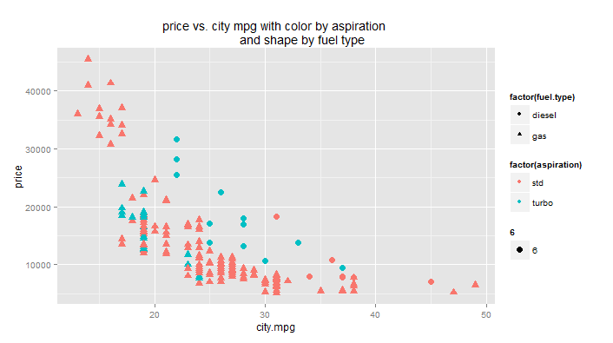
Scatter plot (+ shape by category)

Slide 54
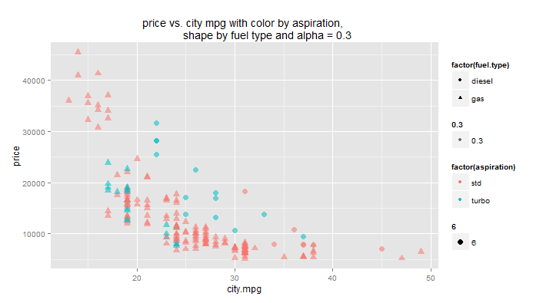
Scatter plot (+ alpha = 0.3)

Slide 55
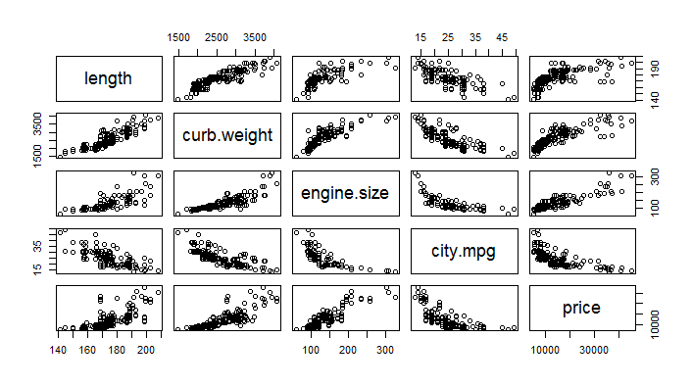
Scatter plot matrix

Slide 56
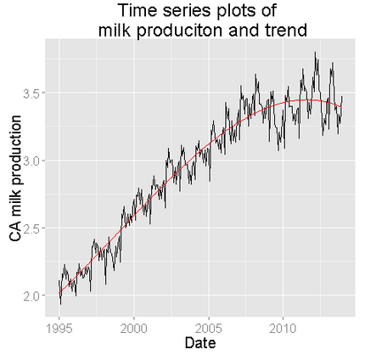
Line plot

Slide 57
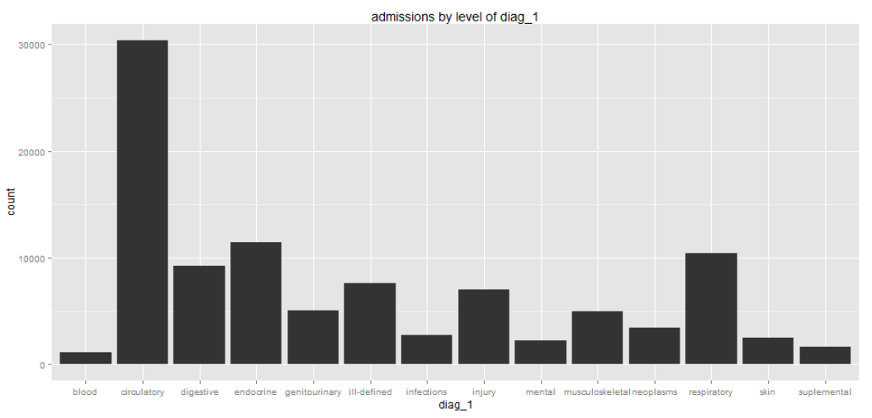
Bar Plot - unordered

Slide 58
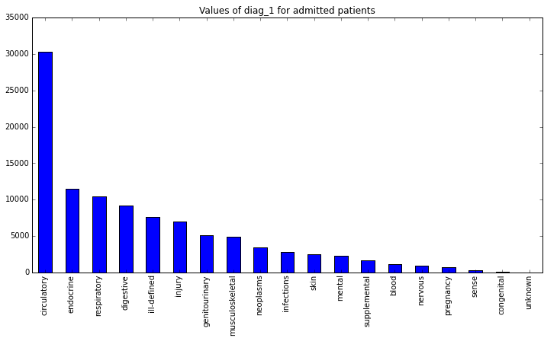
Bar Plot - ordered

Slide 59
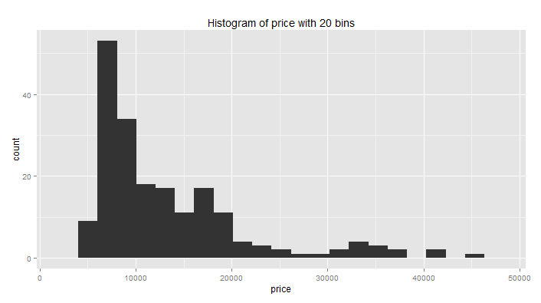
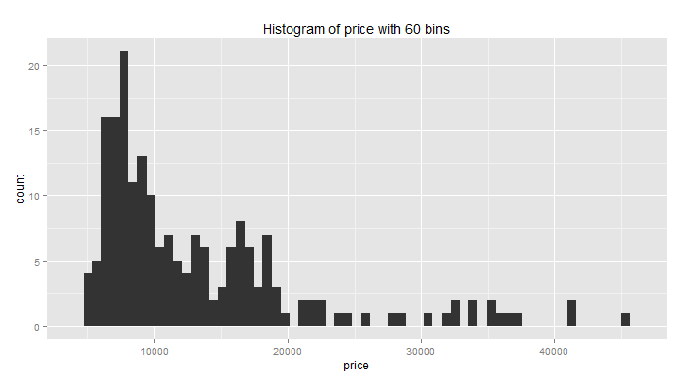
Histogram

Slide 60
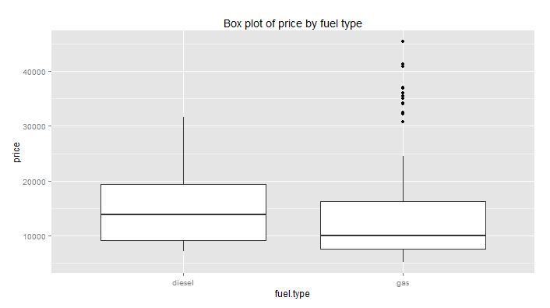
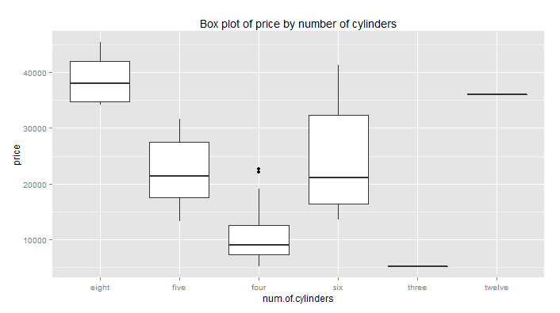
Box Plot (group by category)

Slide 61
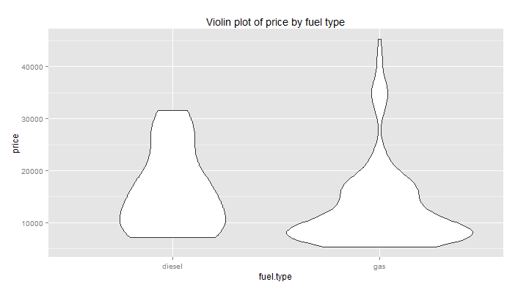
Violin Plot (group by category)

Slide 62
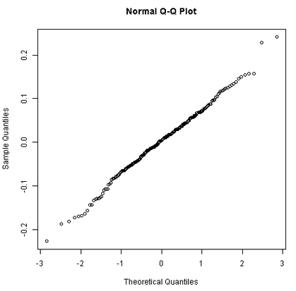
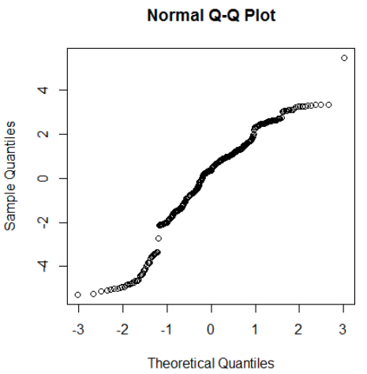
Q-Q Normal Plot

Slide 63
Conditioned Plots

Slide 64
Conditioned plots
How can you project multiple dimensions?
Analog with conditional probability: p( d | g)
Plots of subsets (group by)
Also know as facetted plots
William S. Cleveland, Visualizing Data, 1993, Hobart

Slide 65
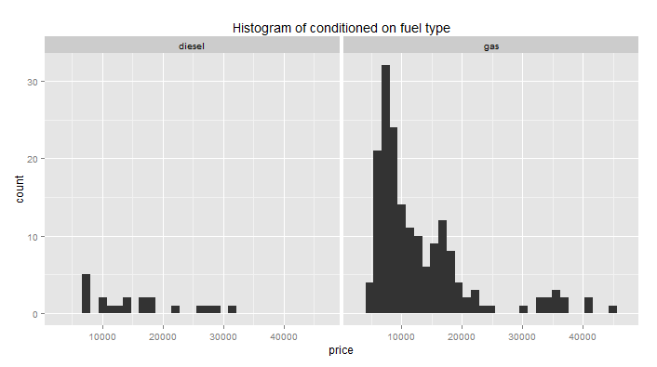
Conditioned plots (faceting)
One conditioning variable

Slide 66
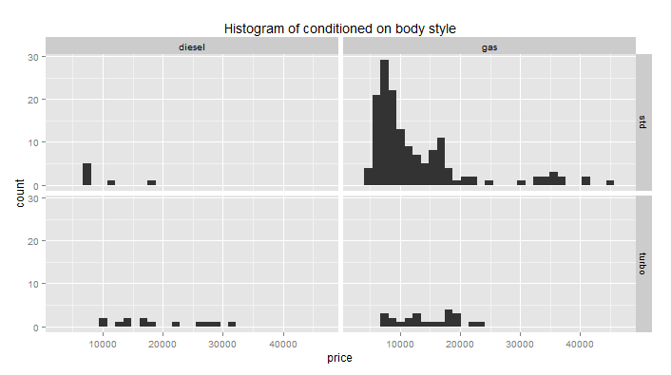
Conditioned plots (faceting)
With two dimensions of conditioning

Slide 67
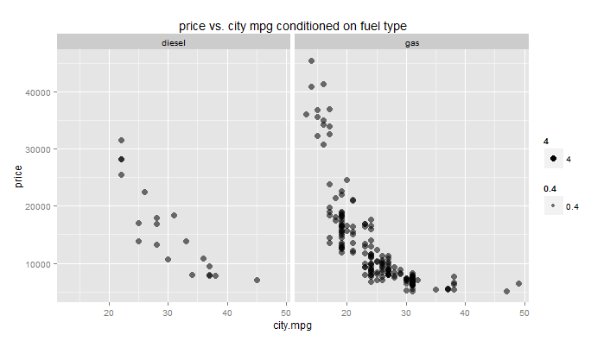
Conditioning (faceting)
With scatter plot

Slide 68
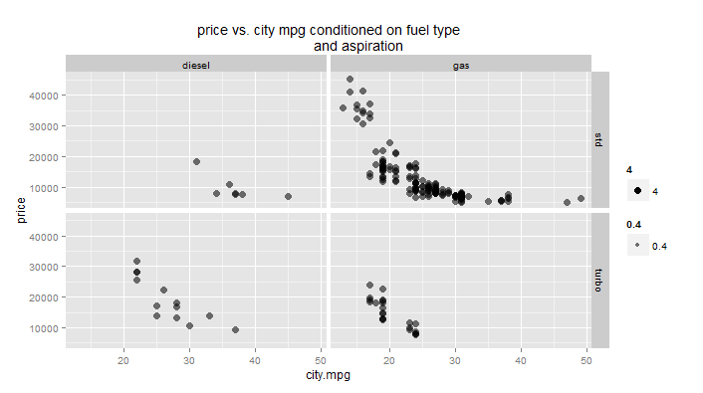
Conditioning (faceting)
With two conditioning categorical variables

Slide 69
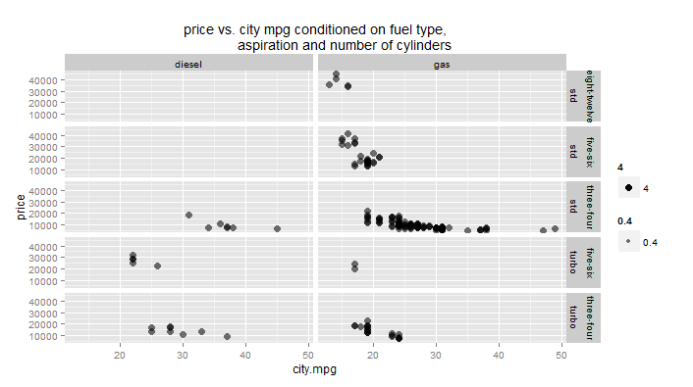
Conditioning (faceting)
With three conditioning categorical variables

Slide 70
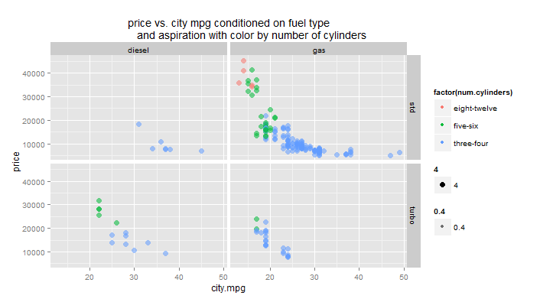
Another view
Different views reveal different relationships

Slide 71
Introduction to ggplot2

Slide 72
Overview of ggplot2
Produces presentation quality charts
Uses grammar of graphics
Operators define graphics properties
Operators chained to create complex plots

Slide 73
The Grammar of Graphics
Import library
Chain methods to define plot
Add attributes to chain
library(ggplot2)
ggplot(dataframe, aes(x = xcol, y = ycol, by = opt))
ggplot(dataframe, aes(x = xcol, y = ycol, by = opt)) + geom_plottype(arguments)
+ xlab("X label") + ylab("Y label") + ggtitle("Title") + other_properties()

Slide 74
ggplot2 Types
geom_bar
geom_boxplot
geom_histogram
geom_line
geom_point
stat_smooth
stat_hexbin

Slide 75
ggplot2 Options and Asthetics
facet_grid()
xlab(), ylab()
ggtitle()
shape
color
alpha
size

Slide 76
Execute R Script
Azure ML Tables
zip file
myFrame <- maml.mapInputPort(1,2)
source("src/myScript.R")
maml.mapOutputPort(“myFrame")
plots
Azure ML Table
R Device Port

Slide 77
Visualizing Data with R

Slide 78
Visualizing Data with R in Azure ML

Slide 79
Introduction to pandas plotting and matplotlib

Slide 80
Python plotting
matplotlib underpins plotting in Python
e.g. matplotlib.pyplot
pandas.DataFrame.plot built on matplotlib.pyplot
Other libraries built on matplotlib
For some plot types of more control use matplotlib.pyplot directly

Slide 81
Pandas Plotting
Import libraries
Define and clear a figure
Define one or more axis
Apply plot method
Save figure
import matplotlib.pyplot as plt
fig1 = plt.figure(figsize=(9, 9))
fig1.clf()
ax = fig1.gca()
pandas.DataFrame.plot(kind = 'someType', ax = ax, ….)
fig1.savefig('scatter2.png')

Slide 82
Python Plotting in Azure ML
def azureml_main(frame1):
import matplotlib.pyplot as plt ## Import libraries
fig1 = plt.figure(figsize=(9, 9)) ## Define a figure
fig1.clf() ## Clear the current figure
ax = fig1.gca() ## Define axis to plot
pandas.DataFrame.plot(kind = 'someType', ax = ax, ….)
fig1.savefig('scatter2.png') ## Save figure in a file for output
return frame1 ## Must return a Pandas dataframe

Slide 83
Types for pandas.DataFrame.plot()
‘line’ : line plot (default)
‘bar’ : vertical bar plot
‘barh’ : horizontal bar plot
‘kde’ or ‘density’: Kernel Density Estimation plot
‘scatter’ : scatter plot

Slide 84
Options and Aesthetics for pandas.DataFrame.plot()
ax – pyplot axis
x, y – coordinates
color – line or symbol color
s – size by value
shape
alpha – transparency

Slide 85
Execute Python Script
Azure ML Tables
zip file
Def azureml_main(inFrame1, inFrame2)
import my_package
return myFrame
fig.savefig(‘fig.png')
Azure ML Table
Python Device Port

Slide 86
Visualizing Data with Python

Slide 87
Visualizing Data with Python in Azure ML

